Slide 1
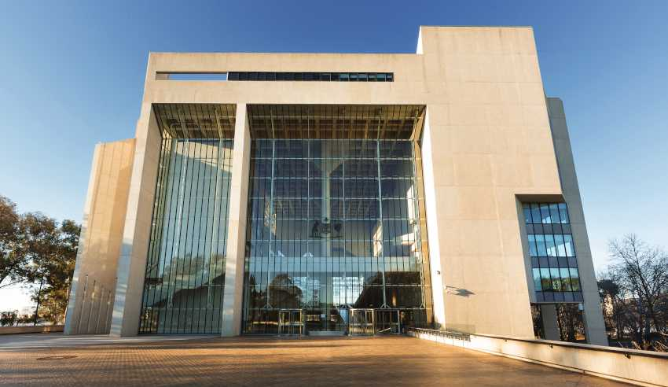

Slide 2
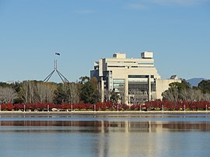

Slide 3
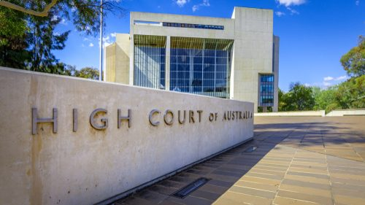

Slide 4
The High Court
L.I: To examine the role of the High Court in Australia.

Slide 5
The Role of the High Court
https://www.hcourt.gov.au/about/high-court-documentary
Complete an RIQ321 while watching the documentary
https://www.youtube.com/watch?v=66vfDU37OrI

